Slide 1

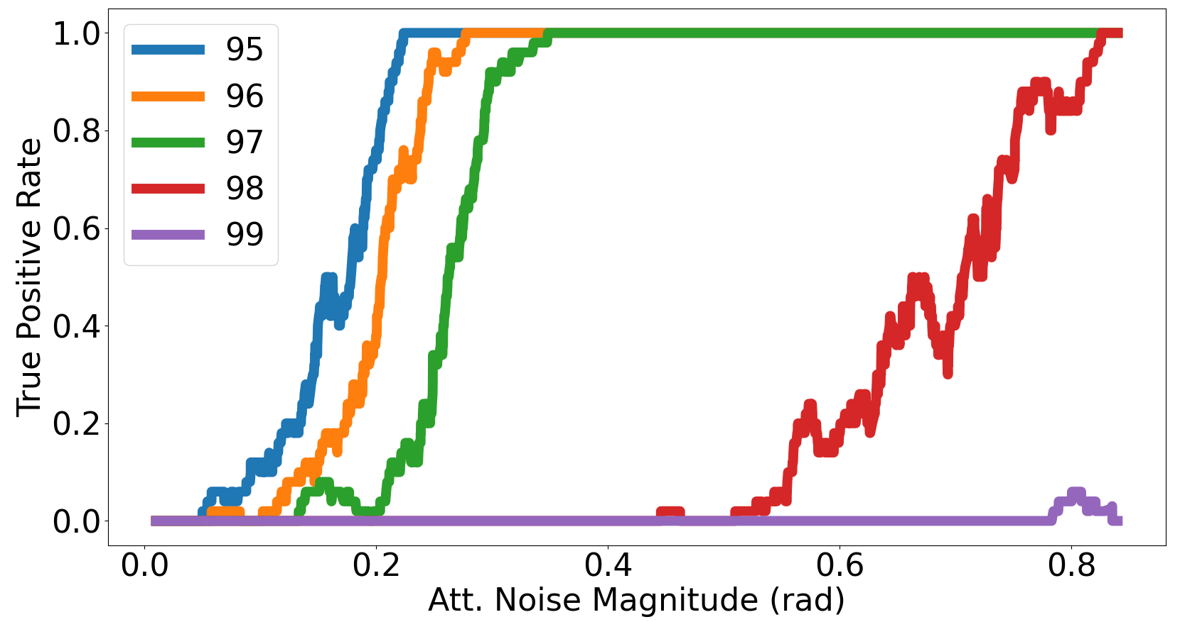
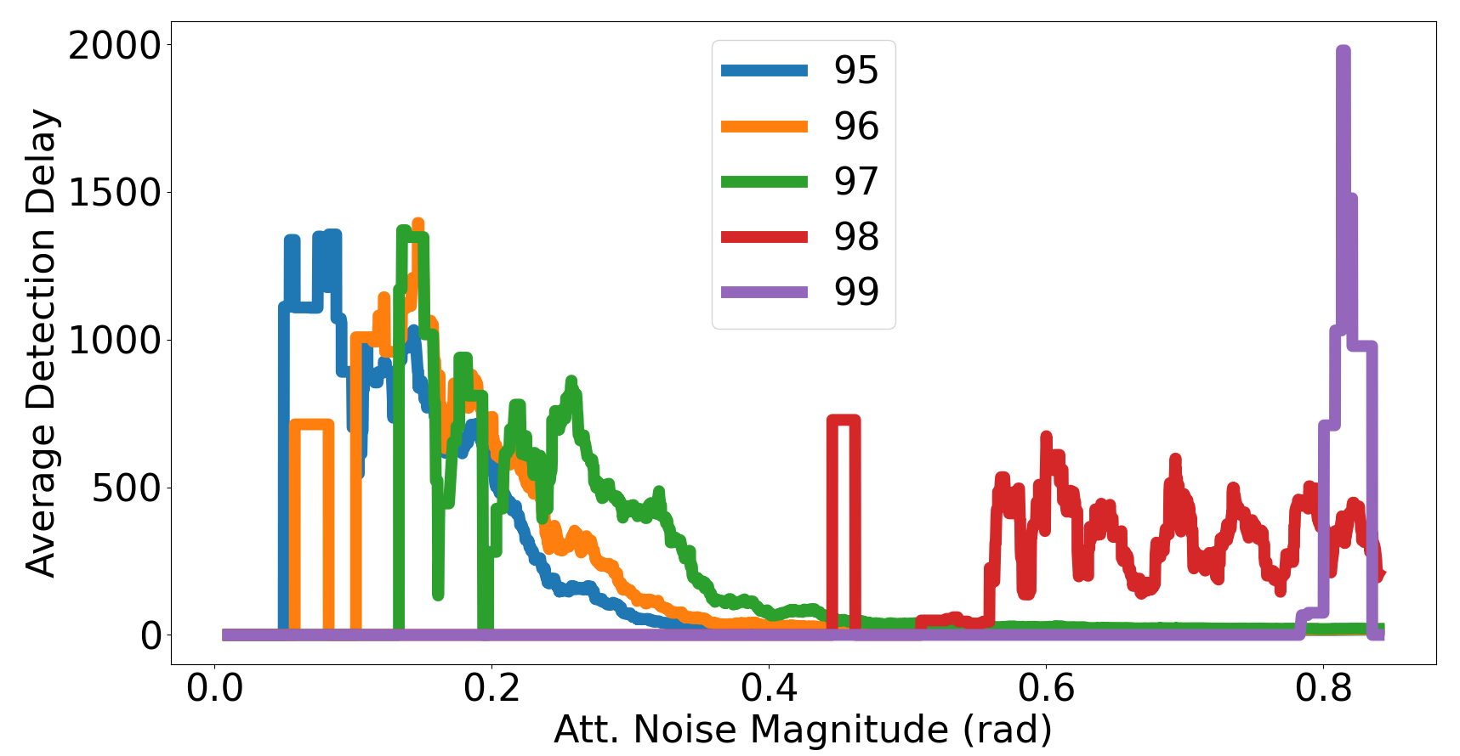
Background
Physical systems can present non-stationary behaviour, engaging in different operating conditions (modes).
Several solutions have been proposed for the control of known operating conditions of non-stationary physical systems.
Real-time adaptation to unknown operating conditions is still an open problem.
Proposed approach
We present the problem of novel mode control in two steps: novel mode detection and control synthesis.
Novel mode detection
We have proposed a data driven approach to detect transtitions from known system behaviours to unknown system behaviours.
Latent space representation of the observable space.
Classifier-based mode identification and novel mode detection.
Providing information on the expected system performance (i.e.: stability, tracking error, etc.) while detecting transitions is still a work in progress.
Main contribution
A learning-based, data-driven, control synthesis methodology for unknown operating conditions in non-stationary systems using multi-model adaptive control as a basis framework for known operating conditions.
Novel mode control
Results
Mode estimation and novel mode detection is a simple task on the quadcopter benchmark.
Reference
Multi-Controller
Control Mixing
Physical System
Novel Control Synthesis
Sensors
Detection rate increases the further the novel mode is from the known configurations.
Multiple model adaptive control solution for known operating conditions.
Multiple low level controllers.
Learning-based control mixing.
Data-driven control synthesis for unknown operating conditions.
Reuse knowledge from control mixing.
Detection delay decreases the further the novel mode is from the known configurations.
Benchmarks
Accepted Papers:
IFAC 2023: Exploring Unknown Plant Configurations under a Multiple Model Adaptive Control Framework.

Slide 2
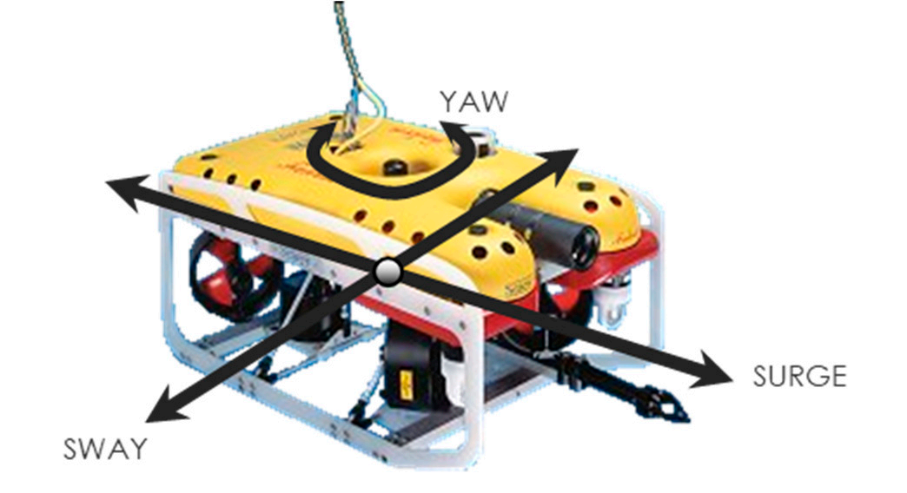
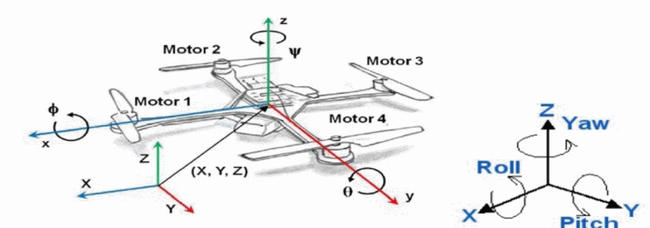
Background
Physical systems can present non-stationary behaviour, engaging in different operating conditions.
Maintaining control guarantees under unknown conditions is an unsolved problem.
Autonomous Underwater Vehicle
Unmanned Aerial Vehicle
Motivation
Learning-supported, data-driven, control solution that adapts to novel operating modes.
Provide stability and performance guarantees.
Cross-platform validation.
Novel mode detection
Explore projections between plant space and control parameter space.
Latent space representation of the observable space.
Classifier-based mode identification and novel mode detection.
Results
Mode estimation and novel mode detection is a simple task on the quadcopter benchmark.
Novel mode control
Detection rate increases the further the novel mode is from the known configurations.
Reference
Multi-Controller
Physical System
Supervisor
Sensors
Detection delay decreases the further the novel mode is from the known configurations.
Multiple model adaptive control low level solution (providing stability guarantees).
Learning-based supervisor.
Supervisor
Two distinct reinforcement learning tasks.
Select low level controllers.
Tune new controller.
Knowledge from offline learning used for online tuning.
Submissions:
IFAC 2023: Exploring Unknown Plant Configurations under a Multiple Model Adaptive Control Framework.
Visits:
Visit to University of Limerick: Interaction with autonomous underwater vehicle simulator.
Novel Low Level Controller Tuning (Online Learning)
Low Level Controller Mixing (Offline learning)

